Slide 1
Distributed and Cloud Computing K. Hwang, G. Fox and J. Dongarra Chapter 1: Enabling Technologies and Distributed System Models
Notes:
‹#›

Slide 2
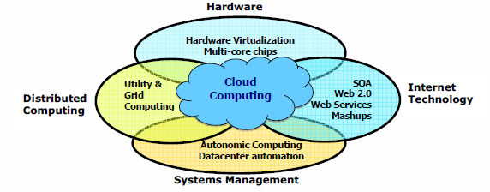
Data Deluge Enabling New Challenges
(Courtesy of Judy Qiu, Indiana University, 2011)
Notes:
‹#›

Slide 3
From Desktop/HPC/Grids to Internet Clouds in 30 Years
HPC moving from centralized supercomputers to geographically distributed desktops, desksides, clusters, and grids to clouds over last 30 years
R/D efforts on HPC, clusters, Grids, P2P, and virtual machines has laid the foundation of cloud computing that has been greatly advocated since 2007
Location of computing infrastructure in areas with lower costs in hardware, software, datasets, space, and power requirements – moving from desktop computing to datacenter-based clouds
Notes:
‹#›

Slide 4
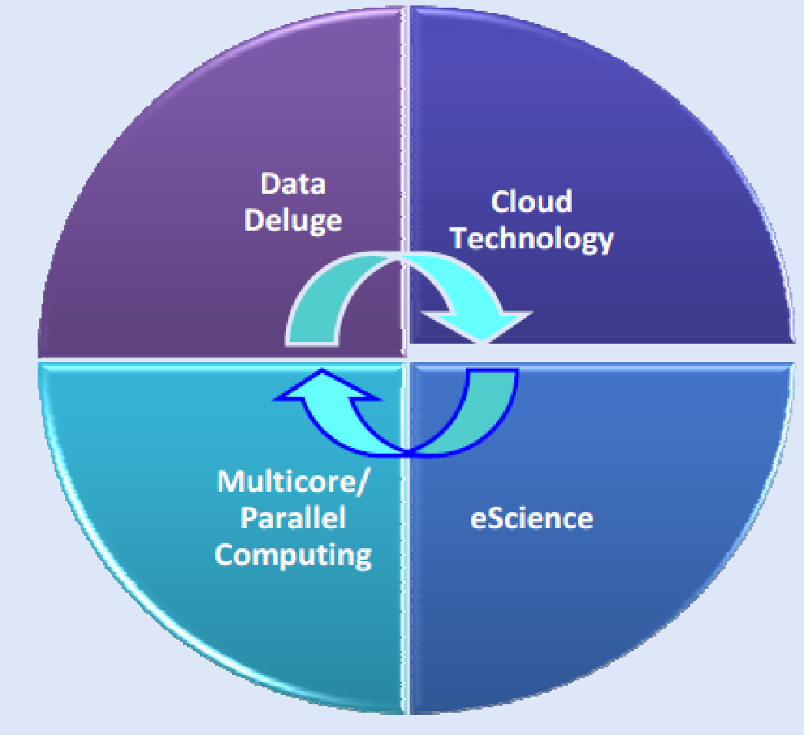
Interactions among 4 technical challenges : Data Deluge, Cloud Technology, eScience, and Multicore/Parallel Computing
(Courtesy of Judy Qiu, Indiana University, 2011)
Notes:
‹#›

Slide 5
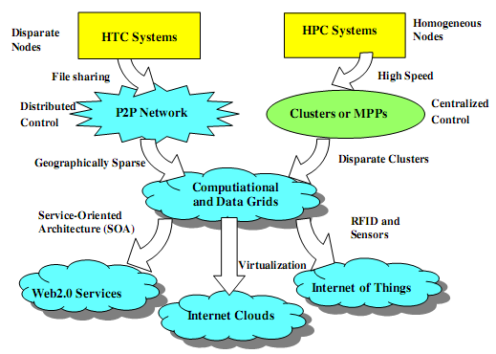
Clouds and Internet of Things
HPC: High-Performance Computing
HTC: High-Throughput Computing
P2P: Peer to Peer
MPP: Massively Parallel Processors
Source: K. Hwang, G. Fox, and J. Dongarra, Distributed and Cloud Computing, Morgan Kaufmann, 2012.
Notes:
‹#›

Slide 6
Computing Paradigm Distinctions
Centralized Computing
All computer resources are centralized in one physical system.
Parallel Computing
All processors are either tightly coupled with central shard memory or loosely coupled with distributed memory
Distributed Computing
Field of CS/CE that studies distributed systems. A distributed system consists of multiple autonomous computers, each with its own private memory, communicating over a network.
Cloud Computing
An Internet cloud of resources that may be either centralized or decentralized. The cloud apples to parallel or distributed computing or both. Clouds may be built from physical or virtualized resources.
Notes:
‹#›

Slide 7
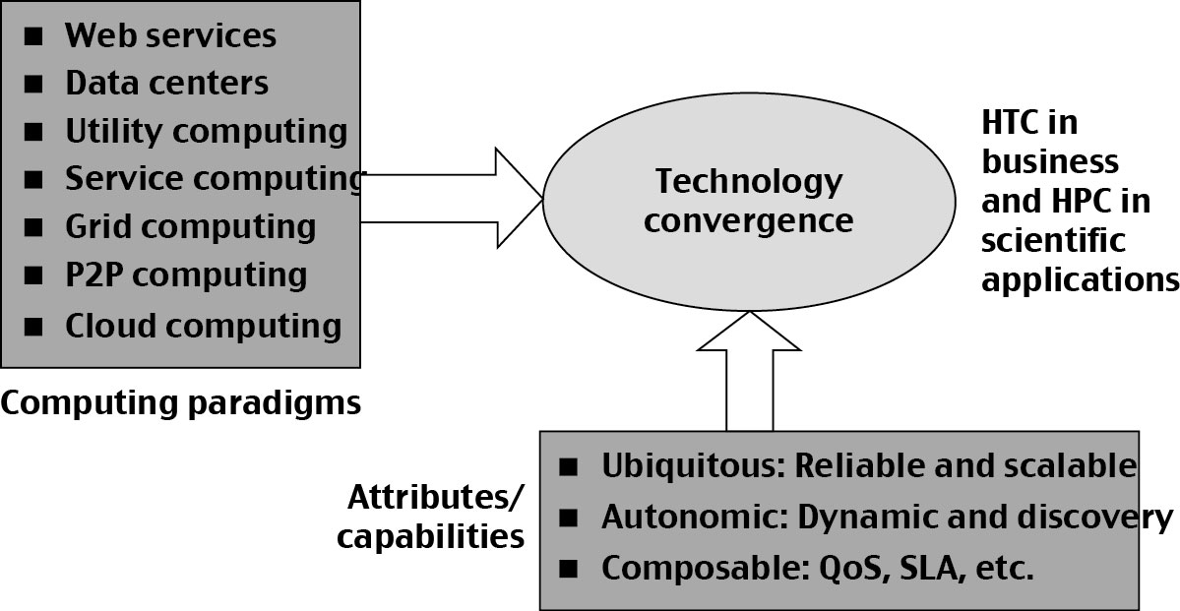
Technology Convergence toward HPC for Science and HTC for Business: Utility Computing
(Courtesy of Raj Buyya, University of Melbourne, 2011)
Copyright © 2012, Elsevier Inc. All rights reserved.
Notes:
‹#›

Slide 8
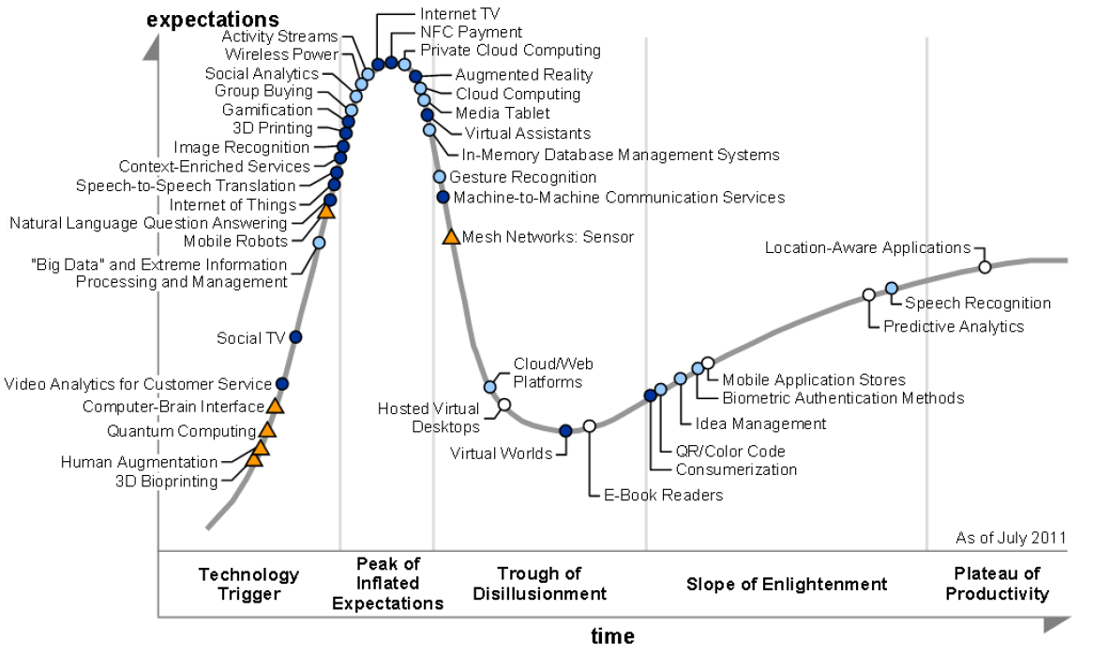
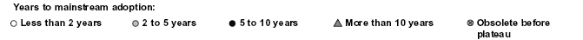
2011 Gartner “IT Hype Cycle” for Emerging Technologies
2010
2009
2011
2008
2007
Copyright © 2012, Elsevier Inc. All rights reserved.
Notes:
‹#›

Slide 9
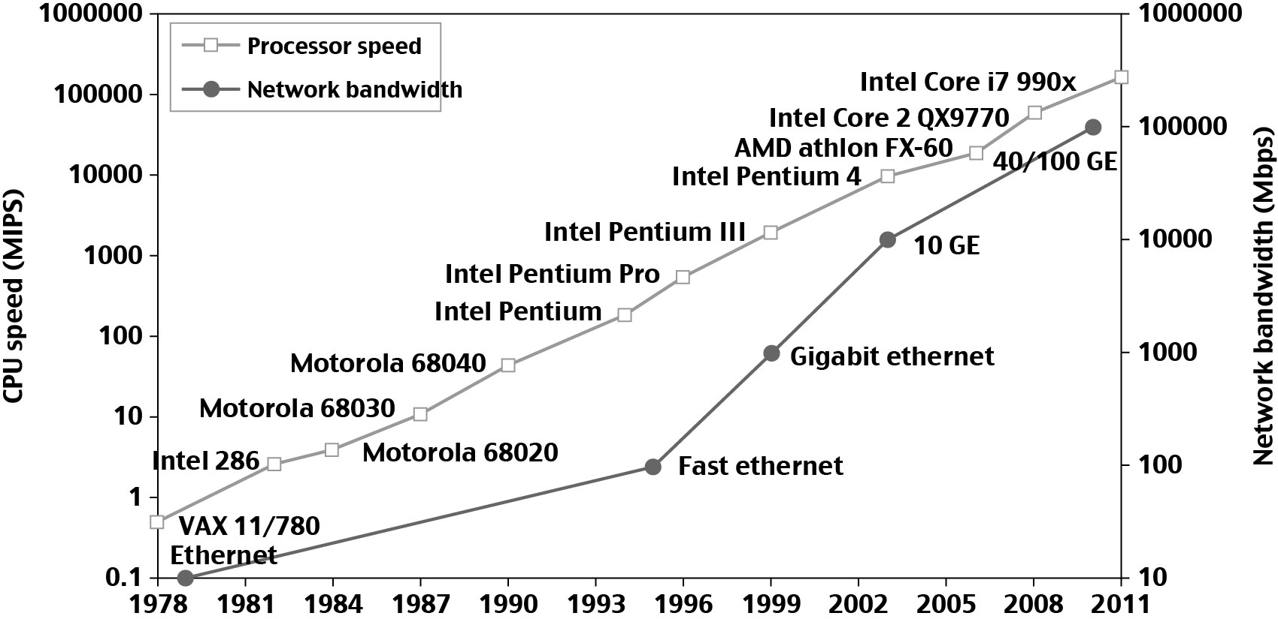
33 year Improvement in Processor and Network Technologies
Technologies for Network-based Systems
Notes:
‹#›

Slide 10
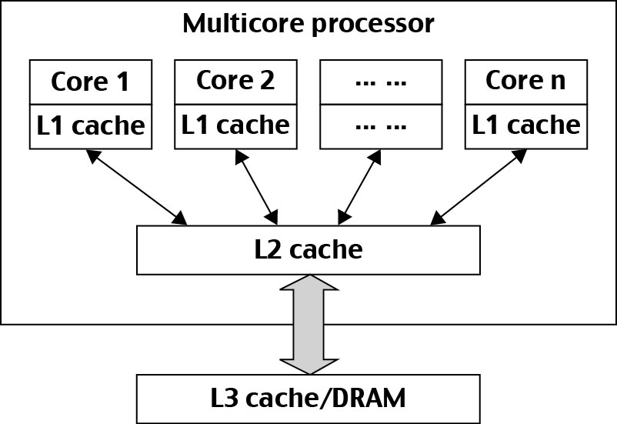
Modern Multi-core CPU Chip
Notes:
‹#›

Slide 11
Multi-threading Processors
Four-issue superscalar (e.g. Sun Ultrasparc I)
Implements instruction level parallelism (ILP) within a single processor.
Executes more than one instruction during a clock cycle by sending multiple instructions to redundant functional units.
Fine-grain multithreaded processor
Switch threads after each cycle
Interleave instruction execution
If one thread stalls, others are executed
Coarse-grain multithreaded processor
Executes a single thread until it reaches certain situations
Simultaneous multithread processor (SMT)
Instructions from more than one thread can execute in any given pipeline stage at a time.
Notes:
‹#›

Slide 12
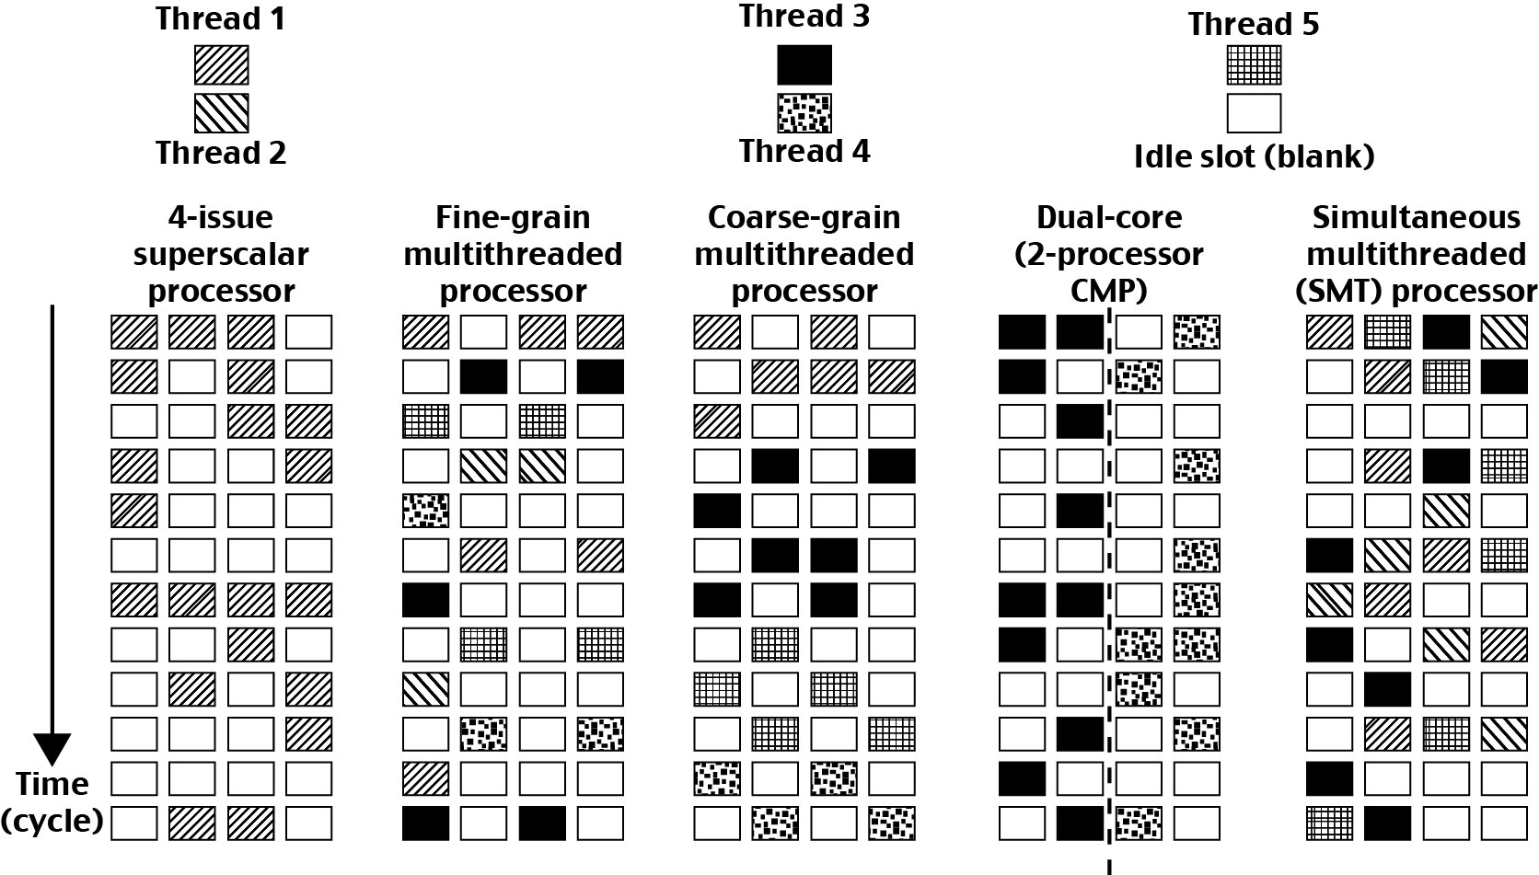
5 Micro-architectures of CPUs
Each row represents the issue slots for a single execution cycle:
A filled box indicates that the processor found an instruction to execute in that issue slot on that cycle;
An empty box denotes an unused slot.
Notes:
‹#›

Slide 13
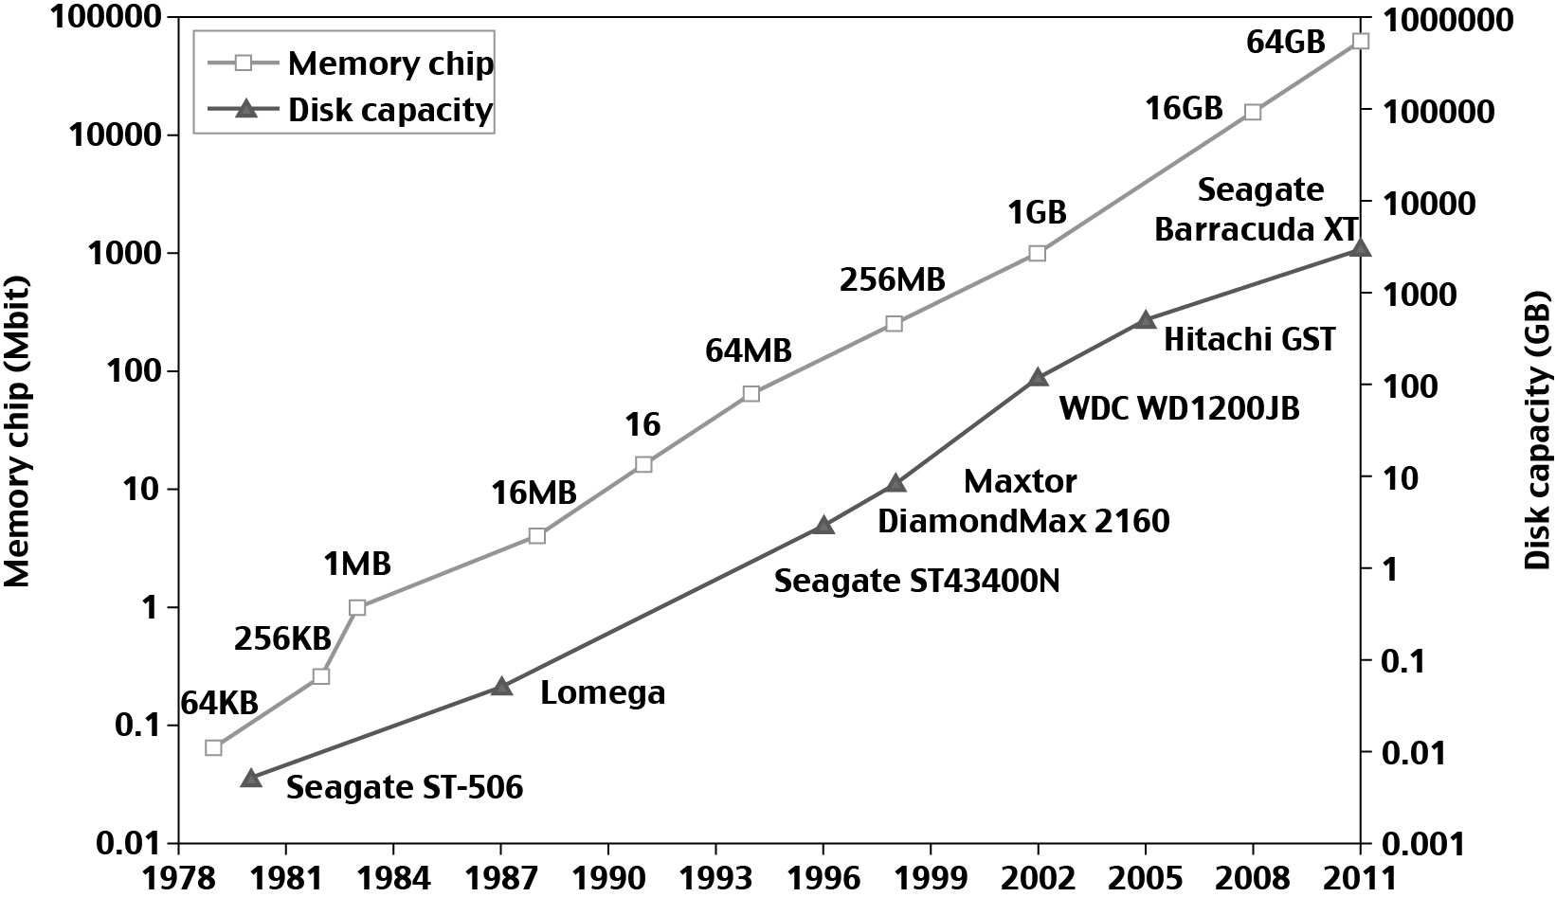
33 year Improvement in Memory and Disk Technologies
Notes:
‹#›

Slide 14
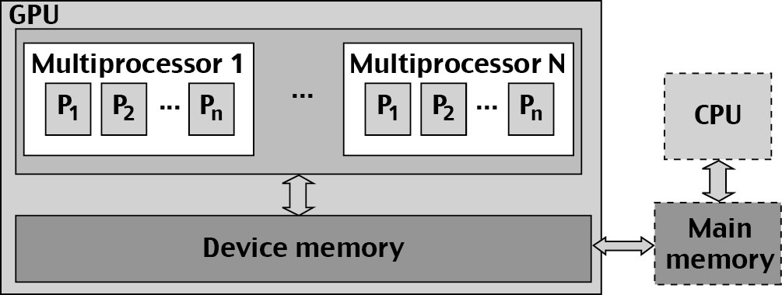
Architecture of A Many-Core Multiprocessor GPU interacting with a CPU Processor
Notes:
‹#›

Slide 15
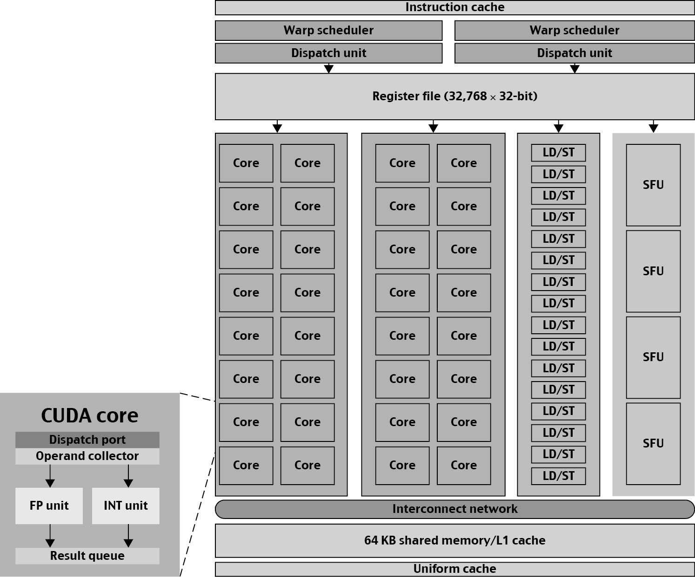
NVIDIA Fermi GPU
Notes:
‹#›

Slide 16
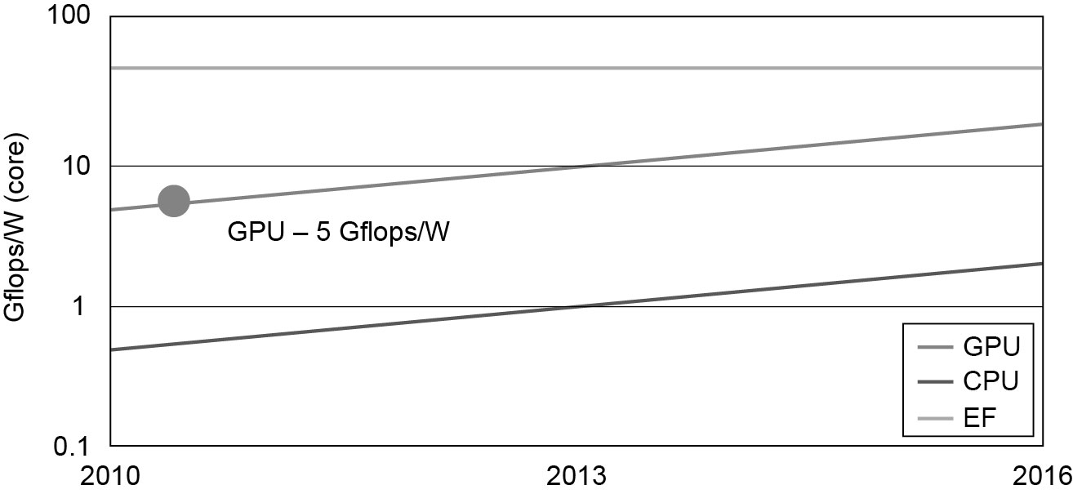
GPU Performance
Bottom – CPU - 0.8 Gflops/W/Core (2011)
Middle – GPU - 5 Gflops/W/Core (2011)
Top - EF – Exascale computing (10^18 Flops)
Notes:
‹#›

Slide 17
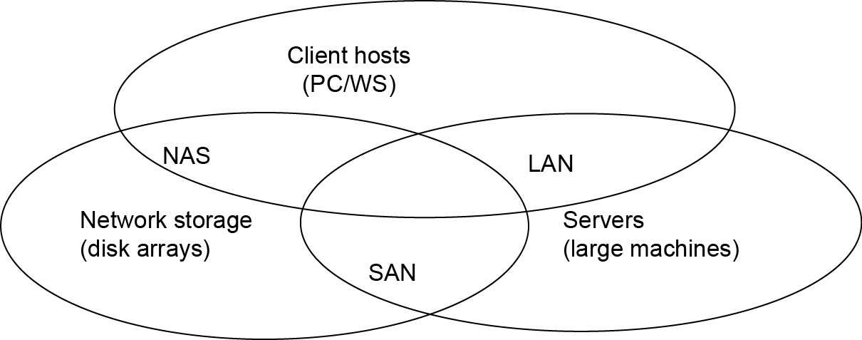
Interconnection Networks
SAN (storage area network) - connects servers with disk arrays
LAN (local area network) – connects clients, hosts, and servers
NAS (network attached storage) – connects clients with large storage systems
Notes:
‹#›

Slide 18
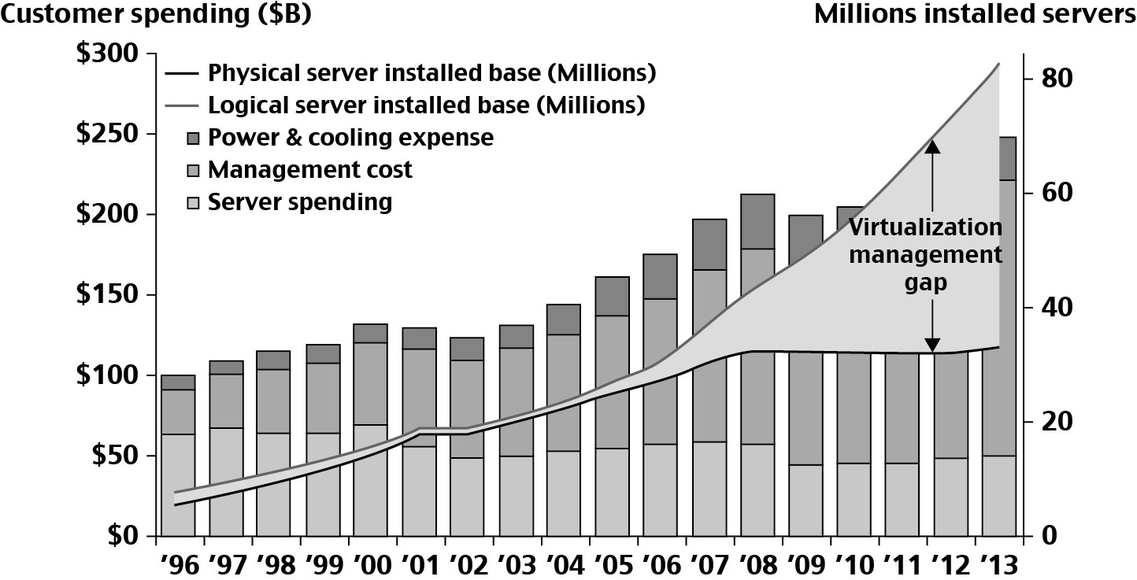
Datacenter and Server Cost Distribution
Notes:
‹#›

Slide 19
Virtual Machines
Eliminate real machine constraint
Increases portability and flexibility
Virtual machine adds software to a physical machine to give it the appearance of a different platform or multiple platforms.
Benefits
Cross platform compatibility
Increase Security
Enhance Performance
Simplify software migration
Notes:
‹#›

Slide 20
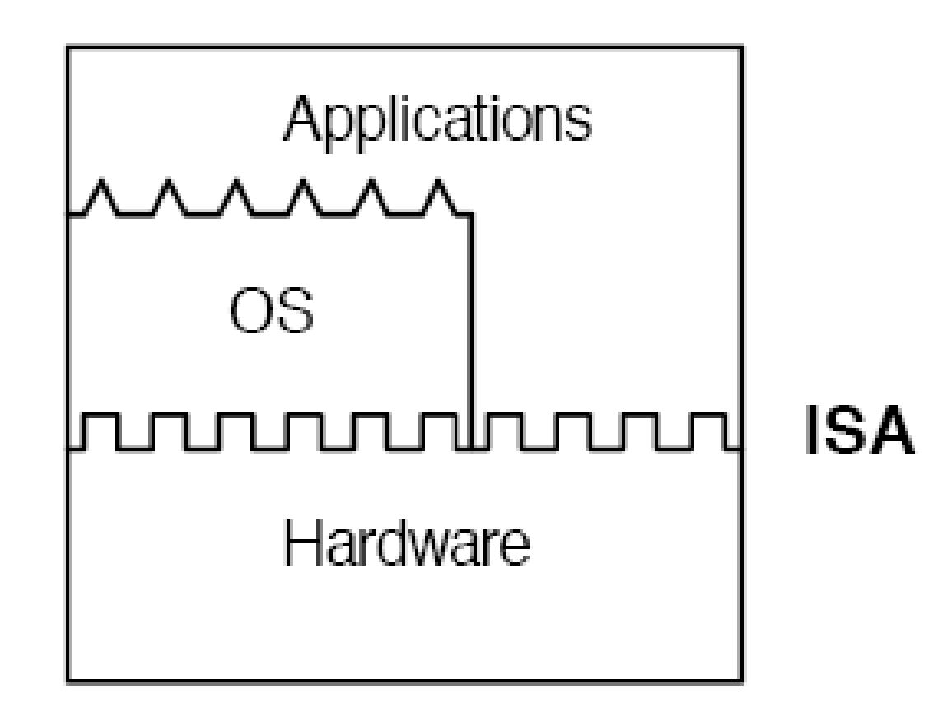
Initial Hardware Model
All applications access hardware resources (i.e. memory, i/o) through system calls to operating system (privileged instructions)
Advantages
Design is decoupled (i.e. OS people can develop OS separate of Hardware people developing hardware)
Hardware and software can be upgraded without notifying the Application programs
Disadvantage
Application compiled on one ISA will not run on another ISA..
Applications compiled for Mac use different operating system calls then application designed for windows.
ISA’s must support old software
Can often be inhibiting in terms of performance
Since software is developed separately from hardware… Software is not necessarily optimized for hardware.
Notes:
‹#›

Slide 21
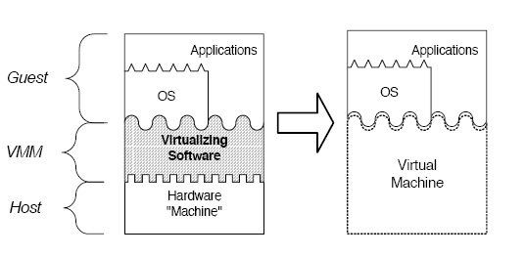
Virtual Machine Basics
Virtual software placed between underlying machine and conventional software
Conventional software sees different ISA from the one supported by the hardware
Virtualization process involves:
Mapping of virtual resources (registers and memory) to real hardware resources
Using real machine instructions to carry out the actions specified by the virtual machine instructions
Notes:
‹#›

Slide 22
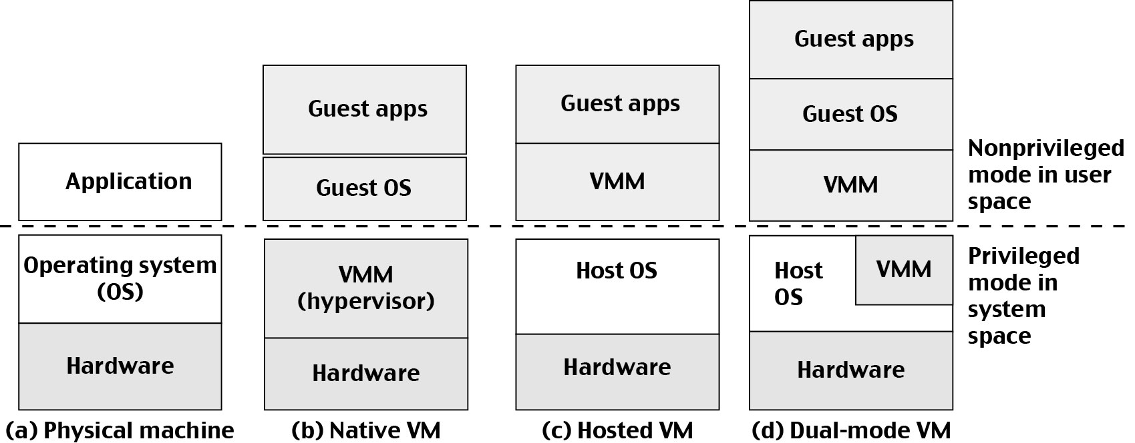
Three VM Architectures
Notes:
‹#›

Slide 23
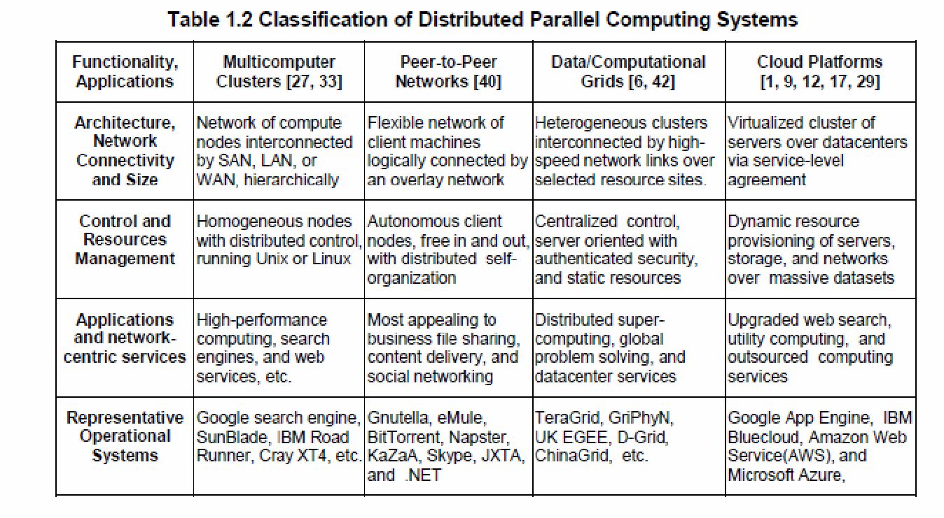
System Models for Distributed and Cloud Computing
Notes:
‹#›

Slide 24
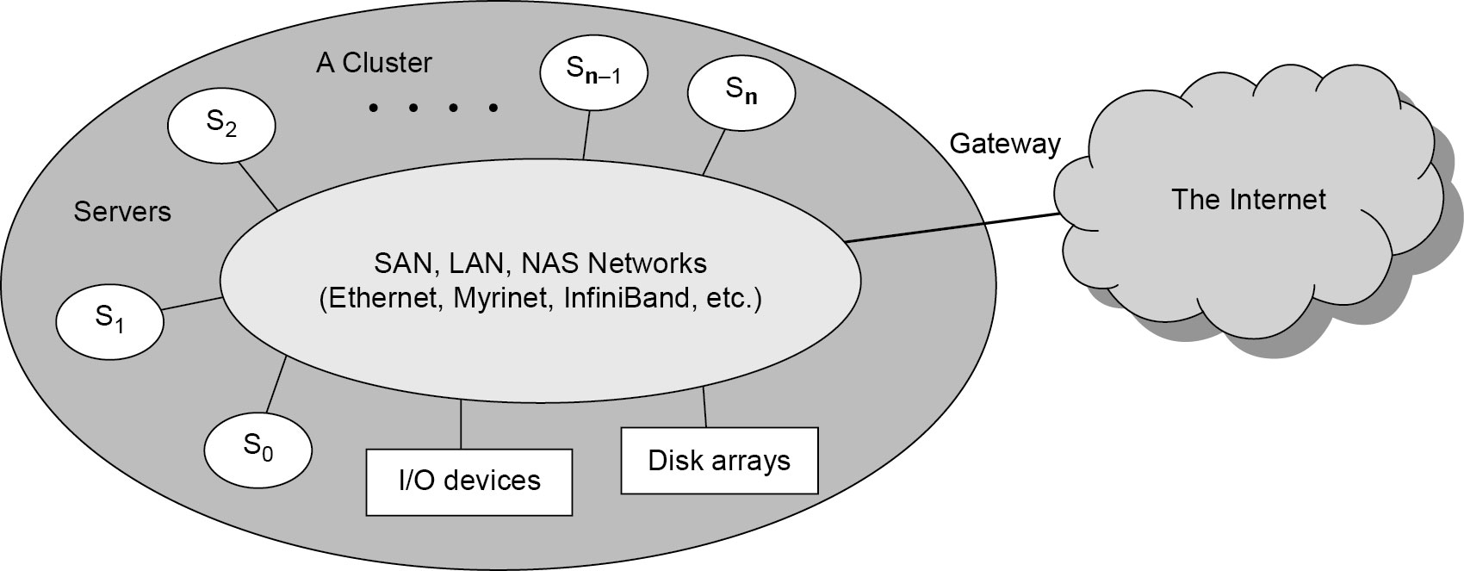
A Typical Cluster Architecture
Notes:
‹#›

Slide 25
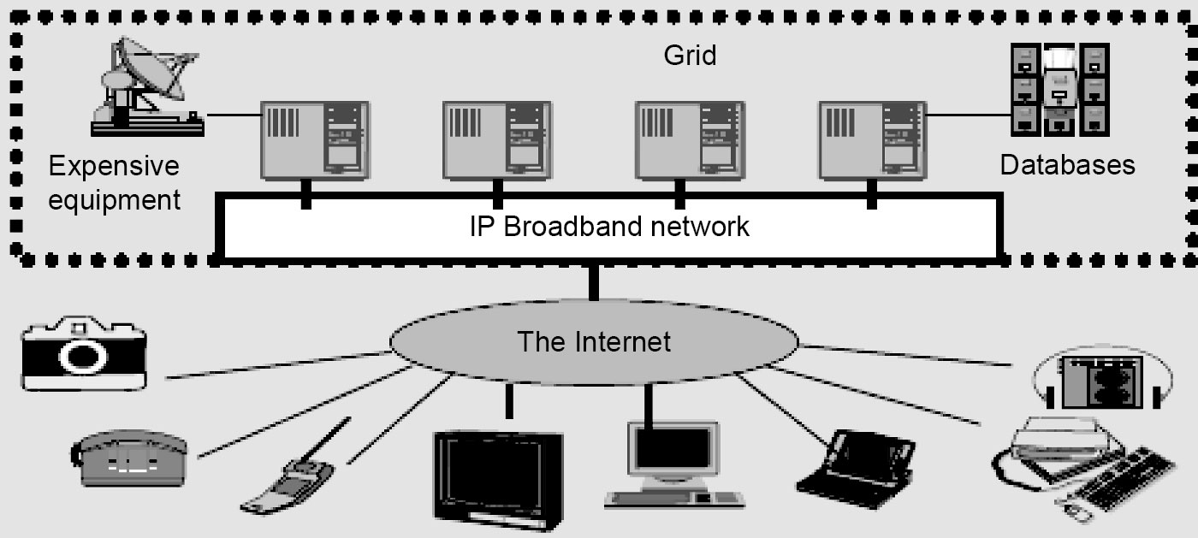
Computational or Data Grid
Notes:
‹#›

Slide 26
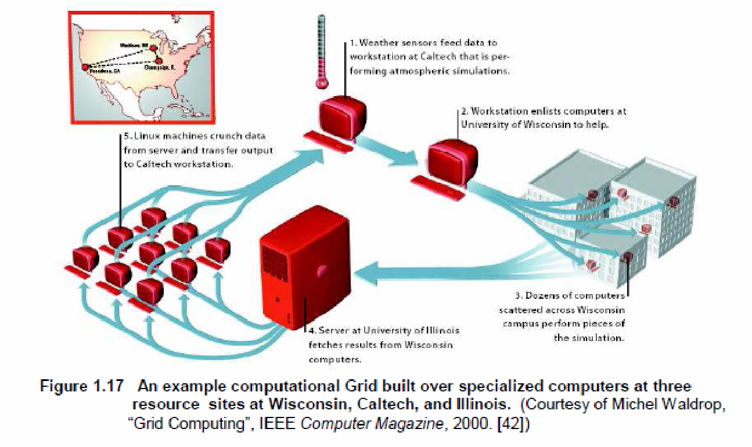
A Typical Computational Grid
Notes:
‹#›

Slide 27
Peer-to-Peer (P2P) Network
A distributed system architecture
Each computer in the network can act as a client or server for other netwpork computers.
No centralized control
Typically many nodes, but unreliable and heterogeneous
Nodes are symmetric in function
Take advantage of distributed, shared resources (bandwidth, CPU, storage) on peer-nodes
Fault-tolerant, self-organizing
Operate in dynamic environment, frequent join and leave is the norm
Notes:
‹#›

Slide 28
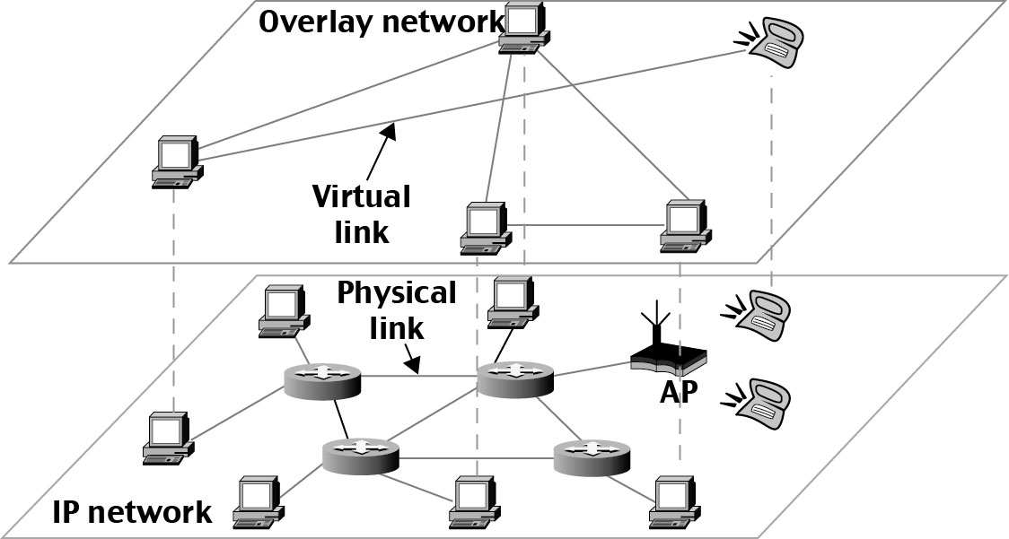
Peer-to-Peer (P2P) Network
Overlay network - computer network built on top of another network.
Nodes in the overlay can be thought of as being connected by virtual or logical links, each of which corresponds to a path, perhaps through many physical links, in the underlying network.
For example, distributed systems such as cloud computing, peer-to-peer networks, and client-server applications are overlay networks because their nodes run on top of the Internet.
Notes:
‹#›

Slide 29
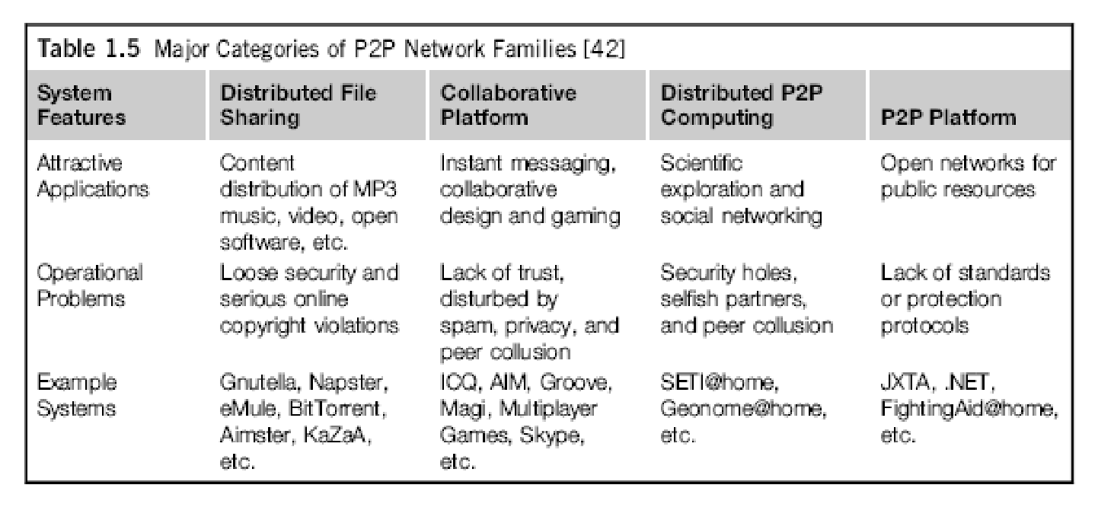
Notes:
‹#›

Slide 30
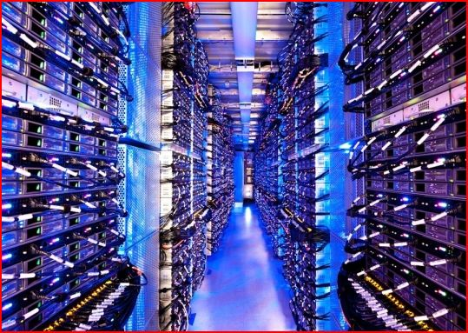

The Cloud
Historical roots in today’s Internet apps
Search, email, social networks
File storage (Live Mesh, Mobile Me, Flicker, …)
A cloud infrastructure provides a framework to manage scalable, reliable, on-demand access to applications
A cloud is the “invisible” backend to many of our mobile applications
A model of computation and data storage based on “pay as you go” access to “unlimited” remote data center capabilities
Copyright © 2012, Elsevier Inc. All rights reserved.
Notes:
‹#›

Slide 31
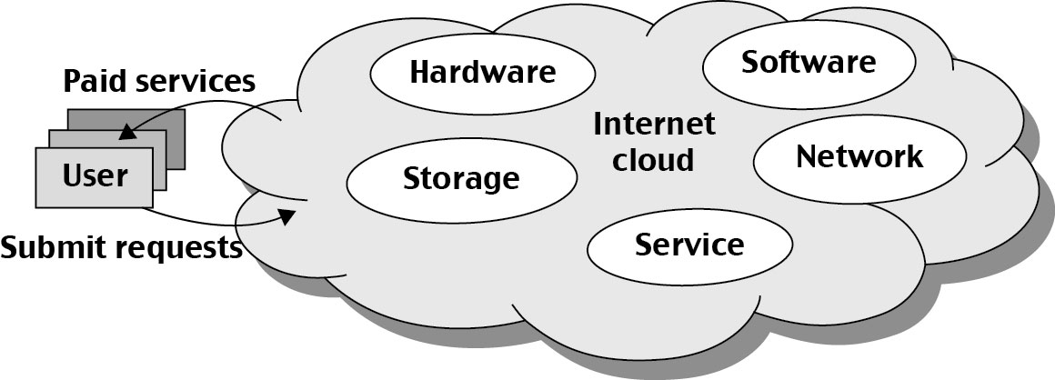
Basic Concept of Internet Clouds
Cloud computing is the use of computing resources (hardware and software) that are delivered as a service over a network (typically the Internet).
The name comes from the use of a cloud-shaped symbol as an abstraction for the complex infrastructure it contains in system diagrams.
Cloud computing entrusts remote services with a user's data, software and computation.
Notes:
‹#›

Slide 32
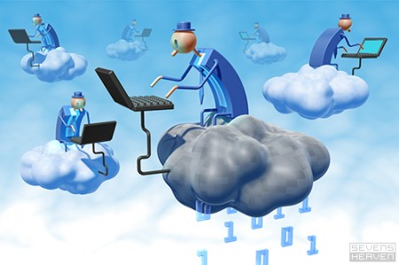
The Next Revolution in IT Cloud Computing
Classical Computing
Buy & Own
Hardware, System Software, Applications often to meet peak needs.
Install, Configure, Test, Verify, Evaluate
Manage
..
Finally, use it
$$$$....$(High CapEx)
Cloud Computing
Subscribe
Use
$ - pay for what you use, based on QoS
Every 18 months?
(Courtesy of Raj Buyya, 2012)
Copyright © 2012, Elsevier Inc. All rights reserved.
Notes:
‹#›

Slide 33
Cloud Service Models (1)
Infrastructure as a service (IaaS)
Most basic cloud service model
Cloud providers offer computers, as physical or more often as virtual machines, and other resources.
Virtual machines are run as guests by a hypervisor, such as Xen or KVM.
Cloud users deploy their applications by then installing operating system images on the machines as well as their application software.
Cloud providers typically bill IaaS services on a utility computing basis, that is, cost will reflect the amount of resources allocated and consumed.
Examples of IaaS include: Amazon CloudFormation (and underlying services such as Amazon EC2), Rackspace Cloud, Terremark, and Google Compute Engine.
Notes:
‹#›

Slide 34
Cloud Service Models (2)
Platform as a service (PaaS)
Cloud providers deliver a computing platform typically including operating system, programming language execution environment, database, and web server.
Application developers develop and run their software on a cloud platform without the cost and complexity of buying and managing the underlying hardware and software layers.
Examples of PaaS include: Amazon Elastic Beanstalk, Cloud Foundry, Heroku, Force.com, EngineYard, Mendix, Google App Engine, Microsoft Azure and OrangeScape.
Notes:
‹#›

Slide 35
Cloud Service Models (3)
Software as a service (SaaS)
Cloud providers install and operate application software in the cloud and cloud users access the software from cloud clients.
The pricing model for SaaS applications is typically a monthly or yearly flat fee per user, so price is scalable and adjustable if users are added or removed at any point.
Examples of SaaS include: Google Apps, innkeypos, Quickbooks Online, Limelight Video Platform, Salesforce.com, and Microsoft Office 365.
Notes:
‹#›

Slide 36
Service-oriented architecture (SOA)
SOA is an evolution of distributed computing based on the request/reply design paradigm for synchronous and asynchronous applications.
An application's business logic or individual functions are modularized and presented as services for consumer/client applications.
Key to these services - their loosely coupled nature;
i.e., the service interface is independent of the implementation.
Application developers or system integrators can build applications by composing one or more services without knowing the services' underlying implementations.
For example, a service can be implemented either in .Net or J2EE, and the application consuming the service can be on a different platform or language.
Notes:
‹#›

Slide 37
SOA key characteristics:
SOA services have self-describing interfaces in platform-independent XML documents.
Web Services Description Language (WSDL) is the standard used to describe the services.
SOA services communicate with messages formally defined via XML Schema (also called XSD).
Communication among consumers and providers or services typically happens in heterogeneous environments, with little or no knowledge about the provider.
Messages between services can be viewed as key business documents processed in an enterprise.
SOA services are maintained in the enterprise by a registry that acts as a directory listing.
Applications can look up the services in the registry and invoke the service.
Universal Description, Definition, and Integration (UDDI) is the standard used for service registry.
Each SOA service has a quality of service (QoS) associated with it.
Some of the key QoS elements are security requirements, such as authentication and authorization, reliable messaging, and policies regarding who can invoke services.
Notes:
‹#›

Slide 38
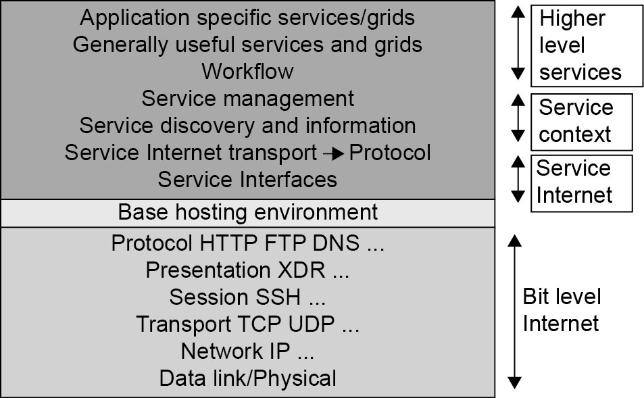
Layered Architecture for Web Services
Notes:
‹#›

Slide 39
Cloud Computing Challenges: Dealing with too many issues (Courtesy of R. Buyya)
Pricing
Scalability
Virtualization
Resource Metering
Reliability
QoS
Billing
Service Level
Agreements
Energy Efficiency
Provisioning
on Demand
Utility & Risk Management
Security
Legal & Regulatory
Privacy
Software Eng. Complexity
Trust
Programming Env. & Application Dev.

Slide 40
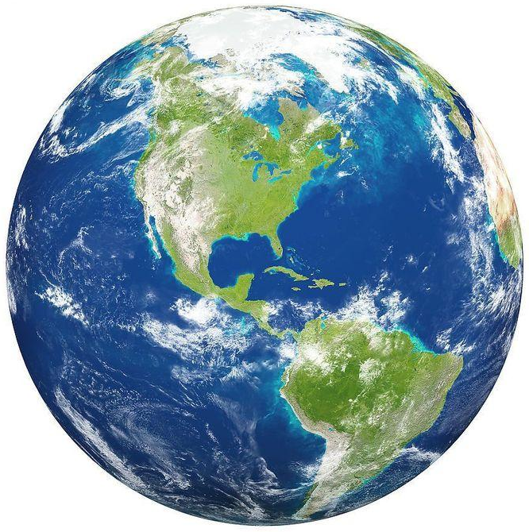
The Internet of Things (IoT)
The Internet
Smart Earth:
An IBM Dream
Internet
Clouds
Internet of Things
Smart Earth
Notes:
‹#›

Slide 41
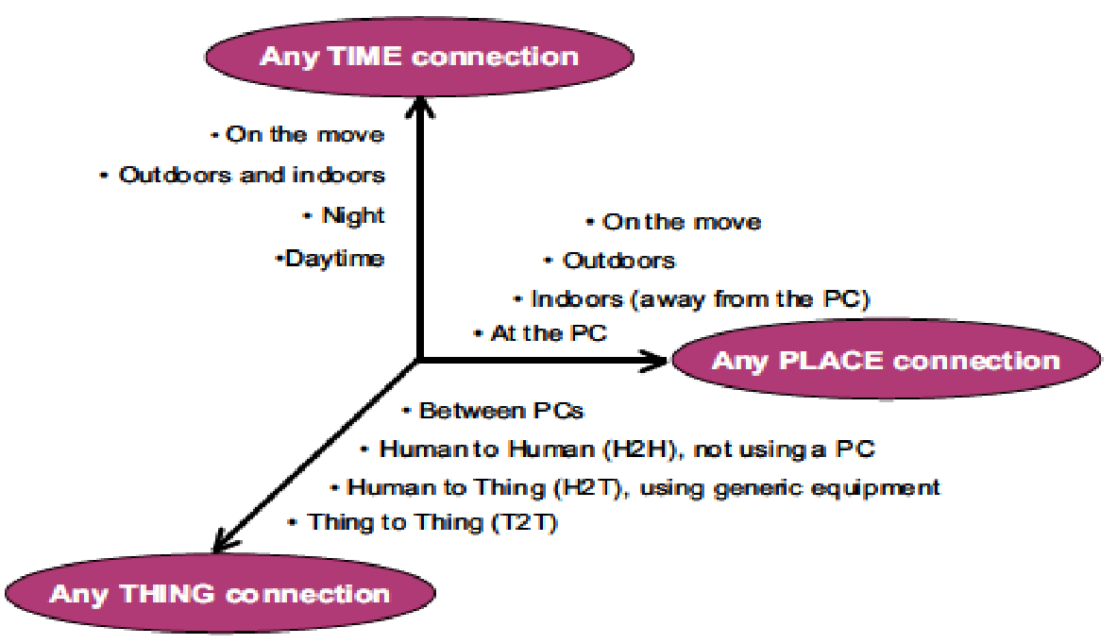
Opportunities of IoT in 3 Dimensions
(courtesy of Wikipedia, 2010)
Notes:
‹#›

Slide 42
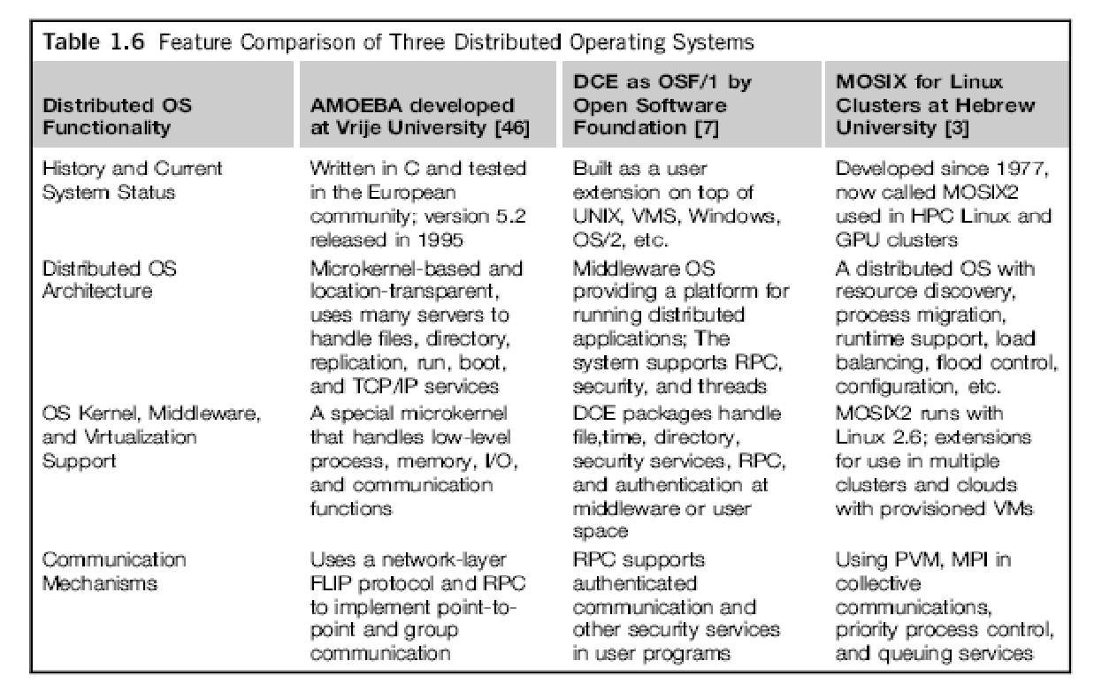
Notes:
‹#›

Slide 43
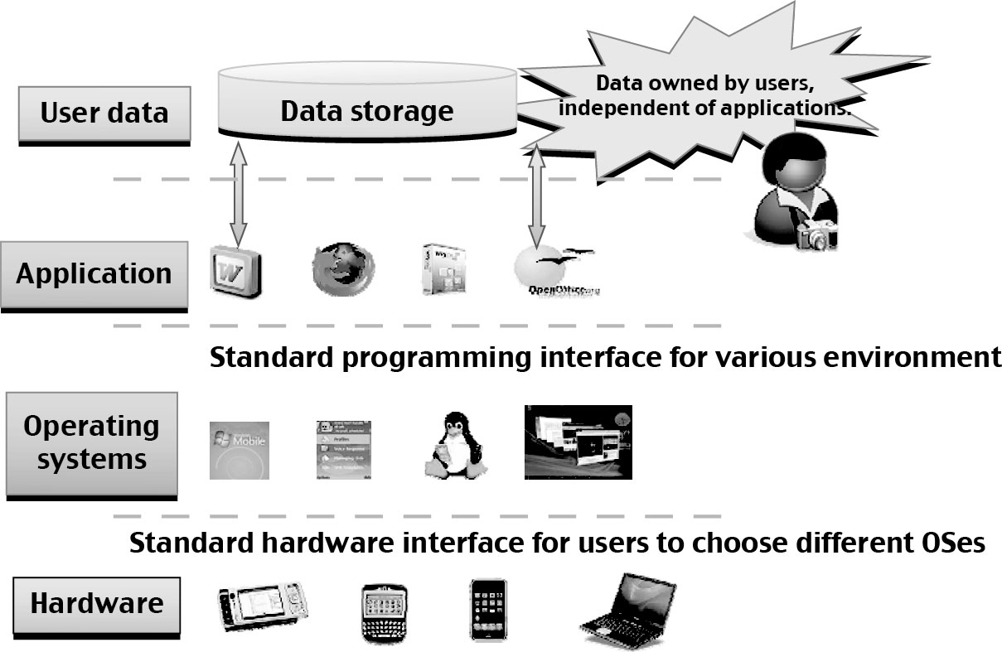
Transparent Cloud Computing Environment
Separates user data, application, OS, and space – good for cloud computing.
Notes:
‹#›

Slide 44
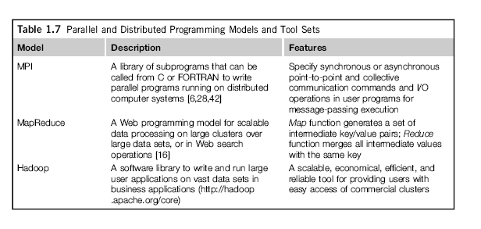
Parallel and Distributed Programming
Notes:
‹#›

Slide 45
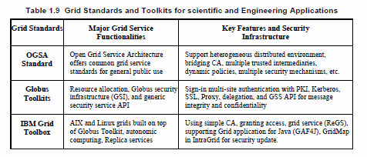
Grid Standards and Middleware :

Slide 46
Dimensions of Scalability
Size – increasing performance by increasing machine size
Software – upgrade to OS, libraries, new apps.
Application – matching problem size with machine size
Technology – adapting system to new technologies
Notes:
‹#›

Slide 47
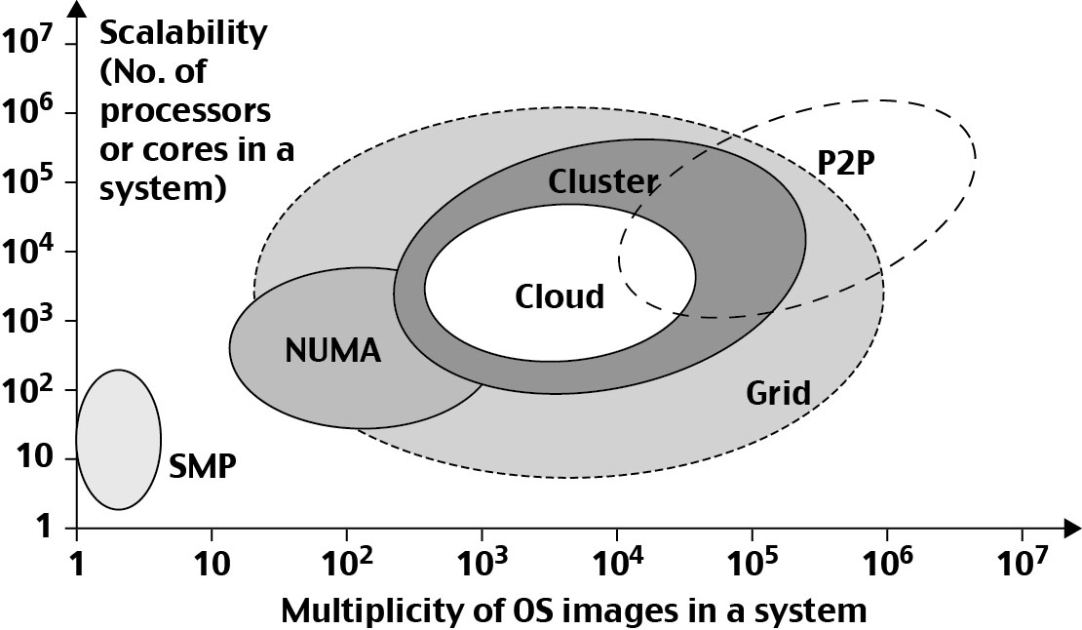
System Scalability vs. OS Multiplicity
Notes:
‹#›

Slide 48
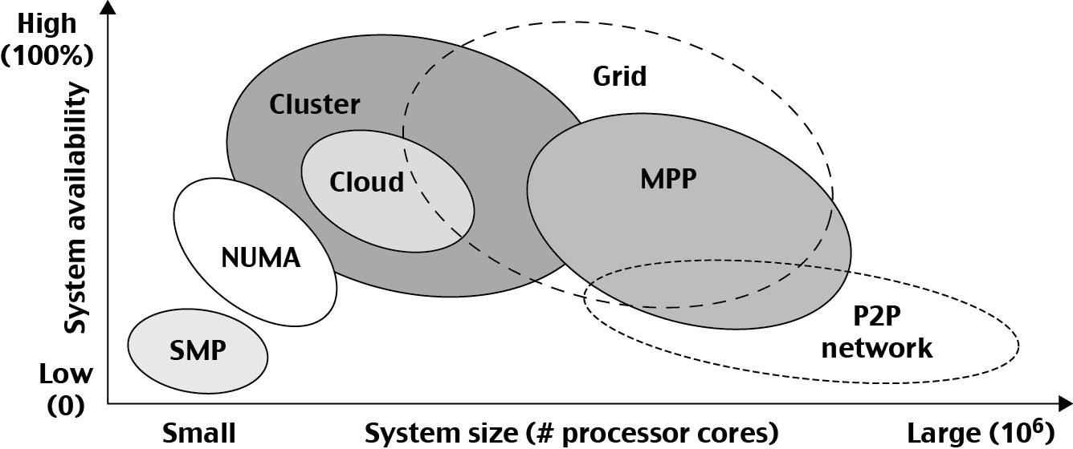
System Availability vs. Configuration Size :
Notes:
‹#›

Slide 49
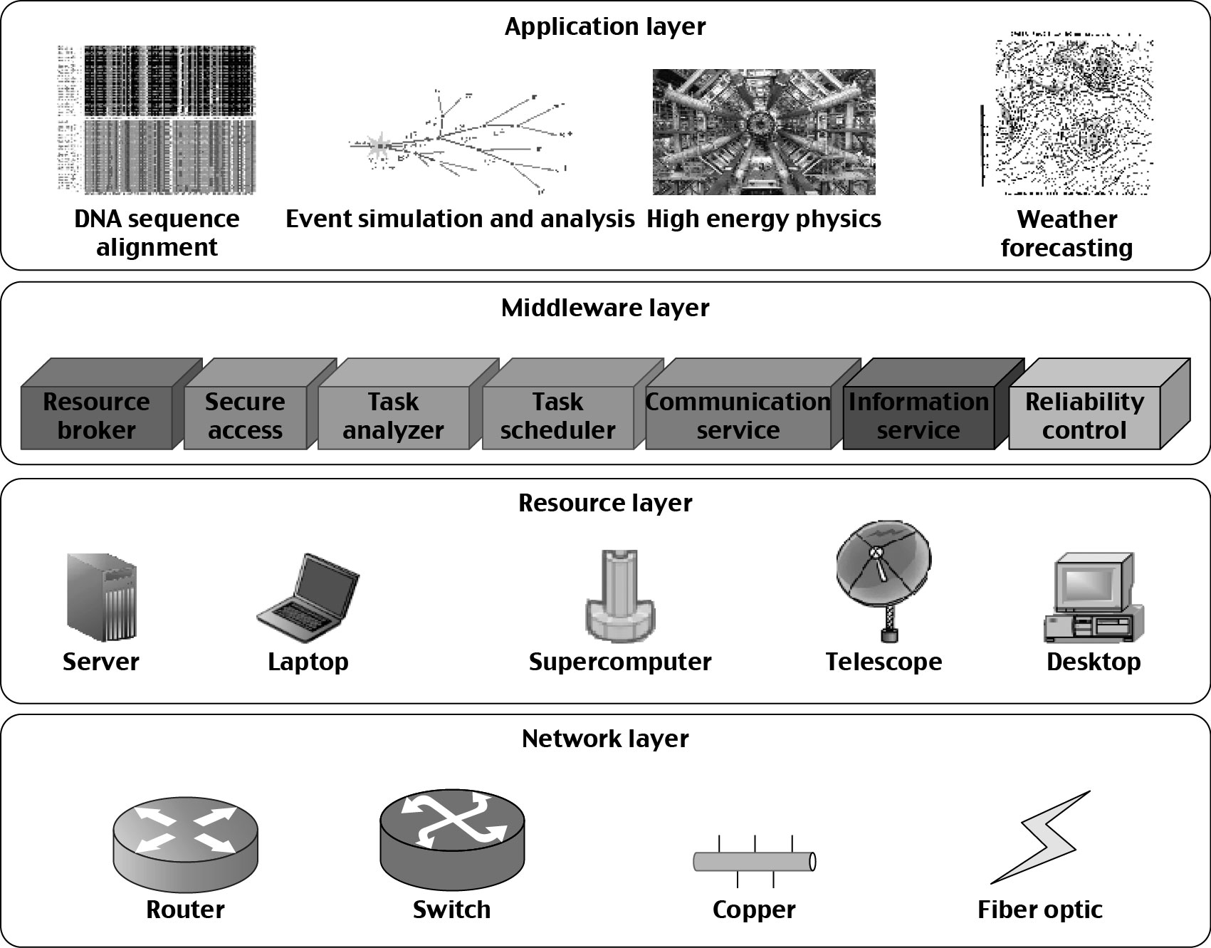
Operational Layers of Distributed Computing System
Notes:
‹#›

Slide 50
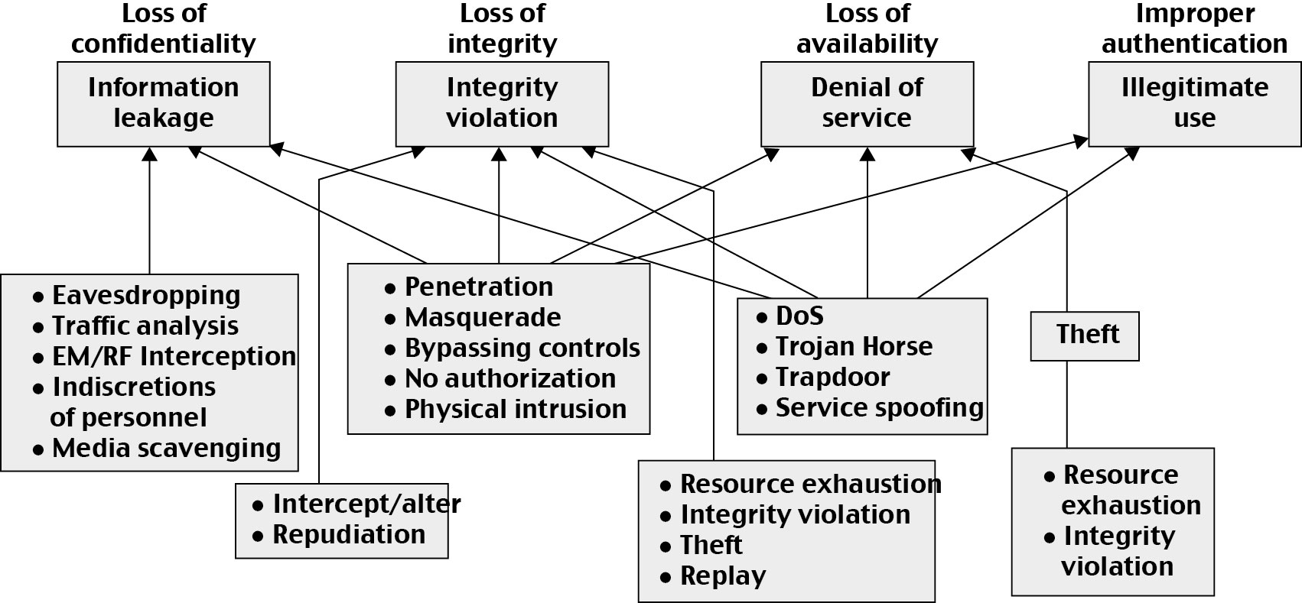
Security: System Attacks and Network Threads
Notes:
‹#›

Slide 51
Four Reference Books:
K. Hwang, G. Fox, and J. Dongarra, Distributed and Cloud Computing: from Parallel Processing to the Internet of Things Morgan Kauffmann Publishers, 2011
R. Buyya, J. Broberg, and A. Goscinski (eds), Cloud Computing: Principles and Paradigms, ISBN-13: 978-0470887998, Wiley Press, USA, February 2011.
T. Chou, Introduction to Cloud Computing: Business and Technology, Lecture Notes at Stanford University and at Tsinghua University, Active Book Press, 2010.
T. Hey, Tansley and Tolle (Editors), The Fourth Paradigm : Data-Intensive Scientific Discovery, Microsoft Research, 2009.
Notes:
‹#›

